Slide 1
Master of Software Engineering
- International Financial Market
软件工程硕士 -国际证券市场
College of Software Technology at Ningbo, Zhejiang University
浙江大学软件学院宁波分院
Class 4 Mutual Fund Basis
Notes:
http://www.investopedia.com/video/play/understanding-ETFs
http://www.investopedia.com/video/play/introduction-mutual-funds
http://www.investopedia.com/video/play/understanding-time-value-of-money
http://www.investopedia.com/video/play/understanding-beta

Slide 2
Learning Objectives
Through this course the students will understand the time value of money, fundamental concepts about Mutual Funds Concepts, Types, Operation, and Investment terminology. Homework and quiz will be given.

Slide 3
推荐教材或主要参考书
1. Name: Mutual Fund industry handbook
美国开放式共同基金
Author: Lee Gremillion
Publisher: Wiley; 1 edition (September 1, 2005)
Language: English/Chinese
Date:
ISBN: 978-0471736240
2. Name: Dictionary of Finance and Investment Terms
Author: John Downes & Jordan Elliot Goodman
Publisher: Barron’s Educational Series, Inc.
Language: English
Date:
ISBN: 0-7641-0790-9
Notes:
The first open-end mutual fund, the Massachusetts Investors Trust was founded by MFS Investment Management on March 21, 1924. After one year, it had 200 shareholders and $392,000 in assets. The entire industry, which included a few closed-end funds, represented less than $10 million in 1924.

Slide 4
Contents
Session 1 Mutual Fund Overview
1. Basic knowledge for time value and return
2. Mutual Funds Overview and Concept
Session 2 Mutual Fund Type and Characters
3. Mutual Fund Term and Prospects
4. Types of Mutual Fund Schemes
Session 3 Mutual Fund Markets
5. Mutual Fund Industry History
6. Mutual fund Organisation
Session 4 Mutual Fund Organization & Analysis
7. Mutual Fund Analysis
8. Collective Intelligence Investment

Slide 5
Session 1 Mutual Fund Overview

Slide 6
What dose time value of money mean?
This is one of the most basic financial principle
The idea that money available at the present time is worth more than the same amount in the future due to its potential earning capacity. This core principle of finance holds that, provided money can earn interest, any amount of money is worth more the sooner it is received.

Slide 7
Draw a time line
A time line is simply a diagram of the cash flows associated with a TVM problem.
PV₀
FV₅
I = 3.5%
0 1 2 3 4 5
$1,500
$300
$2,500
- $800
Cash Flow

Slide 8
The Time Value of Money(货币的时间价值)
终值：Future value (FV) involves projecting the cash flows forward on basis of an appropriate compound interest rate.
现值：Present value (PV) brings the cash flows back to the beginning of the investment’s life based on an appropriate compound rate of return.
时间线：A time line is simply a diagram of the cash flows associated with a TVM problem.
  A cash flow that occurs in the present (today) is put at time 0.
  Cash outflows (payments) are given a negative sign.
  Cash inflows (receipts) are given a positive sign.
  Discounting calculate the PV to the beginning of the investment period.
  Compounding calculate the FV to the end of period.
Notes:
货币的时间价值：
http://www.investopedia.com/video/play/understanding-time-value-of-money

Slide 9
The Time Value of Money
Stated annual interest rates, or nominal rates – Financial institution usually quote rates
Periodic rates – the rate of interest earned over a single compounding period
Effective annual rate (EAR) – annual rate of return actually being earned after adjustments have been made for different compounding periods.
EAR = ( 1 + periodic rate) ^{m} – 1
Where:
Periodic rate(期间利率) = nominal rate/m
M = the number of compounding periods per year
Notes:
复利终值：F = P(1+i)^{n}
复利符号：(F/P，i，n)
单利：F=P+ n* I
复利次数：M
期间利率：
Effective annual rate (EAR)：有效年利率

Slide 10
Computing EAR
If the nominal rate is 12%, compounded quarterly, compute EAR
Answer:
  Here m = 4, so the periodic rate is 12/4 = 3%
  Thus, EAR = ( 1 + 0.03) ⁴ – 1 = 1.1255 – 1 = 0.1255 = 12.55%
Computing EARs for a range of compounding frequencies
Using a stated rate of 6%, compute EARs for semiannual, quarterly, monthly, and daily compounding.
Answer:
  Semiannual compounding = (1 + 3%)² – 1 = 6.09%
  Quarterly compounding = (1 + 0.015)⁴ – 1 = 6.136%
  Monthly compounding = (1 + 0.005)¹² – 1 = 6.168%
  Daily compounding = (1 + 0.00016438)³⁶⁵ – 1 = 6.183%
  Continuous compounding = exp( 6%) - 1= 6.184%

Slide 11
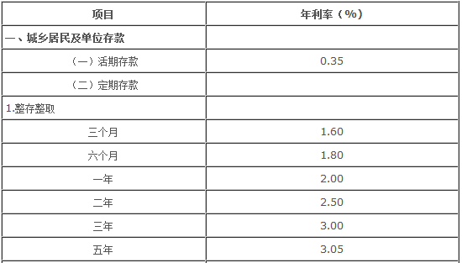
人民币存款利率表 2015/08/26

Slide 12
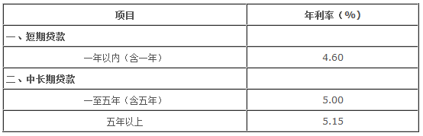

各项贷款利息 2015/08/26
商业贷款
住房公积金贷款

Slide 13
Future Value and Present Value
FV = PV( 1 + i) ^{n}
PV = FV / ( 1 + i)^{n}
Present Value of a Perpetuity
PV = PMT/ i
Notes:
i=interest rate
FV=Future Value(终值)
PV=Present Value(现值)
Notes:
复利终值：F = P(1+i)^{n}
复利符号：(F/P，i，n)
单利：F=P+ n* I
复利系数表:
http://www.lstvu.net.cn/kj/cwgl/xsbcx/02.htm

Slide 14
Money-weighted return and Time-weighted return
The money-weighted return is defined as the internal rate of return on a portfolio, taking into account all cash inflows and outflows.
The time-weighted return measures compound growth.
Example of the money-weighted return
  Assume an investor buys a share of stock for $100 at t = 0 and at the end of the first year (t=1),she buys an additional share for $120. At the end of year 2, the investor sells both shares for $130 each. At the end of each year in the holding period, the stock paid a $2.00 per share dividend. What are the money-weighted return and time-weighted return
 | T=0 | T=1 | T=2
Purchase | 1 stock @ $100 | 1 stock @ $ 120
Sale |  |  | 2 stocks @ $ 130= $260
Dividend |  | 2 $ | 2*2 = 4 $

Slide 15
Money-weighted return and time-weighted return
Money-weighted return（资本加权收益率）
  Step 1: Determine the timing of each flow and inflow(+) and outflow(-)
  t = 0: purchase of first share = -$100.00
  t = 1: dividend from first share = +$2.00
  purchase of second share = -$120.00
  Subtotal, t = 1 -$118.00
  t = 2: dividend from two shares = +$4.00
  proceeds from selling shares = +$260.00
  Subtotal, t = 2 +$264.00
  Step 2: PVoutflows = PVinflows
  $100 + $118/(1+r) = $264/(1+r)²
  Step 3: Solve for r is 13.86%

Slide 16
Money-weighted return and time-weighted return
Time-weighted return (时间加权收益率)
  Step 1: Break the evaluation period into two subperiods:
  Holding period 1: Beginning price = $100.00
  Dividends paid = $2.00
  Ending price = $120.00
  Holding period 2: Beginning price = $240 (2 shares)
  Dividends paid = $4.00 ($2 per share)
  Ending price = $260.00 (2 shares)
  Step 2: Calculate the HPR (holding period rate) for each holding period
  HPR1 = [($120 + 2)/ $100] – 1 = 22%
  HPR2 = [($260 + 4)/ $240] - 1 = 10%
  Step 3: Find the compound annual rate over the 2-year period.
  (1 + time-weighted return) ² = (1+22%)*(1+10%)
  Time-weighted return = 15.84%

Slide 17
Money-weighted return and time-weighted return
In the investment management industry, the time-weighted rate of return is the preferred method of performance measurement, because it is not affected by the timing of cash inflows and outflows.
But, however, if the fund manager has discretion over the timing of cash flow, performance should be evaluated based on Money weighted rate of return.

Slide 18
Definition - What are MFs？
基金是指一种利益共享、风险共担的集合证券投资方式。
  通过发行基金单位，集中投资者的资金，由托管人托管，由基金管理人管理和运用资金，从事股票、债券等金融工具投资，并将投资收益按基金投资者的投资比例进行分配。
  汇集许多小钱凑成大钱，交给专人或专业机构操作管理以获取利润的一种集资式的投资工具。
共同基金其实就是一类投资公司 investment company 。
  每一个共同基金都有各自的经理、员工、运作方式和目标等等。基金的投资目标反映出它之所以成立和存在的理由。共同基金集合了一部分委托人的资金，并代表他们的利益进行有预设目的投资。

Slide 19
Features - Why MF？
1.专业化管理 (Professional Management)
  银行信托部门和私人投资咨询公司为单个投资者提供专业化的管理服务为时已久，但是享有这些服务的最低资产门槛很高，而这正是单个投资者负担不起的。
  共同基金公司聘有专业基金经理人及研究团队从事市场研究，只要花少许的基金管理费就可享受到专家的服务，可以说是小额投资人的最佳福音。
2.成本低 (Cost effective)
  规模经济
3.分散投资风险 (Diversification)
  “不要把所有鸡蛋放在一个篮子里”
  共同基金的资产较一般投资人来得庞大，故足以将资金分散於不同的股票、甚至不同的投资工具中，以达到真正的风险分散，而不致因一支错误的选股而产生重大的亏损

Slide 20
Features - Why MF？(Continue)
4.流动性 (Liquidity)
  共同基金能确保每一位持有人在任何时候，变现其所持有的基金份额。
5.便捷性 (Easy)
  共同基金易于买卖，这种买卖既可直接通过基金家族进行，也可通过经纪人等中介机构办理。
  共同基金为不同投资偏好的投资者提供了广泛的选择。
6.安全性 (Safety)
  监管规范
  共同基金采取资金的保管与经营分开的原则

Slide 21
Disadvantages of Mutual Funds:
Professional Management - Did you notice how we qualified the advantage of professional management with the word "theoretically"? Many investors debate whether or not the so-called professionals are any better than you or I at picking stocks. Management is by no means infallible, and, even if the fund loses money, the manager still takes his/her cut. We'll talk about this in detail in a later section.
Costs - Mutual funds don't exist solely to make your life easier - all funds are in it for a profit. The mutual fund industry is masterful at burying costs under layers of jargon. These costs are so complicated that in this tutorial we have devoted an entire section to the subject.
Dilution - It's possible to have too much diversification. Because funds have small holdings in so many different companies, high returns from a few investments often don't make much difference on the overall return. Dilution is also the result of a successful fund getting too big. When money pours into funds that have had strong success, the manager often has trouble finding a good investment for all the new money.
Taxes - When making decisions about your money, fund managers don't consider your personal tax situation. For example, when a fund manager sells a security, a capital-gains tax is triggered, which affects how profitable the individual is from the sale. It might have been more advantageous for the individual to defer the capital gains liability.
Notes:
第一个是美国版的：上世纪80年代末，鉴于当时投资者对分析师等专业团队产生质疑，《华尔街日报》便组织了一场竞赛，一方是大猩猩，另一方是华尔街的知名分析师（当然，他们不知其竞赛对手是谁）。大分析师选股方法不用说，大家都知道，大猩猩“没文化”，也不懂股票，只好向贴在墙上的股票列表投掷飞镖来确定投资组合，奇迹发生了，在规定的时间里，大猩猩最终收益出人意料的战胜了拥有专业分析能力的分析师。
第二版本是俄罗斯的：俄罗斯莫斯科市马戏团有一只名叫“鲁莎”的大猩猩，大猩猩鲁莎现年5岁，它的主人是俄罗斯家的传奇驯兽师莱夫·多罗夫，鲁莎由于表演卖力，广受欢迎，它名下已经拥有100万卢布（大约21000英镑）的私人资产。主人决定帮鲁莎将这些钱进行投资。他先将30家上市公司的股票名称分别写在30个立方体方块上，然后将这些方块全都摆到鲁莎面前，接着说：“鲁莎，你今年打算将你的钱投资到哪些公司的股票上？”
结果鲁莎若有所思地摆弄了一番这些方块，最后从里面选出8个方块。这8个方块上写着的上市公司名称包括俄罗斯卢克石油公司、天然气工业石油公司、极地黄金公司、伏尔加汽车厂等。
大猩猩鲁莎通过一种主人安排的特殊方法从30家上市公司中挑选出了8家公司，然后由主人帮它将它名下的财产全部购买这8家上市公司的股票,结果股票投资一年翻了近3倍，鲁莎的投资年收益率竟比投资专家和俄罗斯国内94%的基金年收益率还高。令俄罗斯金融专家和股票分析家们目瞪口呆。“通过方块抓阄买股票，基金经理不如大猩猩”。俄媒体开玩笑称，大猩猩鲁莎的成功投资，让基金经理和投资银行家们看起来都像小丑，那些基金经理压根不该获得那么多奖金，而是应该将他们全都送进马戏团。
实际很简单，当市场处于普涨格局时，大猩猩的随机选股方式和专家的投资组合，结果可能并没有很大的差异，甚至可跑赢大盘，比投资专家收益更高。但值得注意，大猩猩只能投掷飞镖选股或抓阄选股，没有配套的仓位控制和风险控制手段，又没有买入、卖出的时机判断及纪律。相当于一辆没有刹车的轿车，司机又没有驾照或没学过交通法规，一旦跑错了方向或跑过了头，就需要承担车毁人亡的风险。在通常情况下看，大猩猩也能开轿车，很风光， 实际上是危险的，因此并不是任何时候都推荐“大猩猩选股法”，大猩猩选股法只有在市场进入普涨的阶段时才有效。且旨在获得中长期收益，其关键是耐心持有而不是择股方法。
而在鄙人在猩猩说股中的“和尚道士法”似乎更科学，短线就用“和尚法”，中长线则用“道士法”。

Slide 22
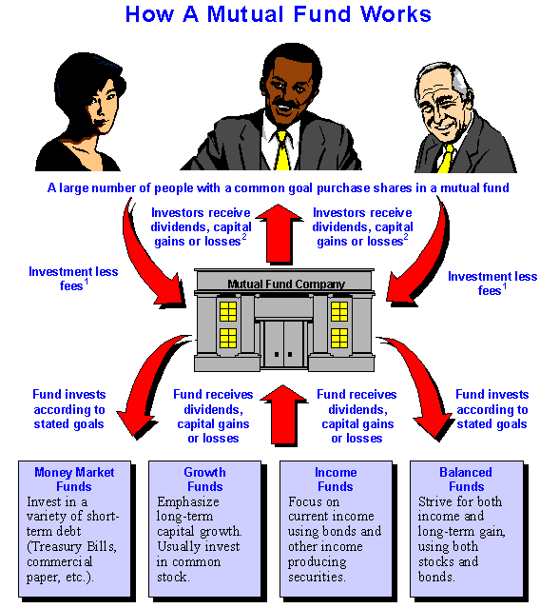
How a Mutual Fund Works

Slide 23
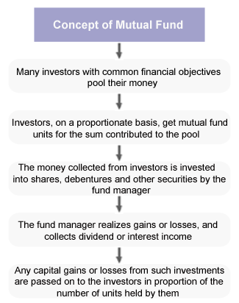
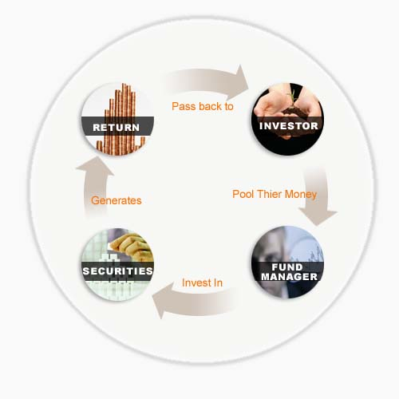
Mutual Fund Cycles

Slide 24
Session 2 Mutual Fund Types and Characters

Slide 25

基金的分类
按照组织形式分为
  公司型基金
  契约型基金
Corporation
Organized under corporate charter
Supervised by board of director
Publicly advertized
Entrance barrier low
Trust
Organized under trust agreement
Supervised by trust committee
Not publicly advertized
Entrance barrier high
AM can be outsource
Mutual Fund

Slide 26
基金的分类
按照募集与流通方式分为
  公募基金
  私募基金 （私募证券投资基金+私募股权基金（PE/VC））
    在出资人间建立了完备的契约合同的民间私下合伙投资
    Mutual Fund（共同基金）
    Hedge Fund (对冲基金)
    Private Equity（私募股权）
按照国别范围分为
  在岸基金 ：本国募集资金并投资于本国证券市场的证券投资基金
  离岸基金：在他国发行证券基金单位并将募集的资金投资于本国或第三国证券市场的证券投资基金 (QDII基金)

Slide 27
基金的分类
按照投资证券类型分为
  股票基金 （权益类）
  债券基金 （中长债，短债，固收类）
  货币市场基金 （隔夜拆借，repo，固收类）
  混合型基金（股票+债券）
  衍生证券投资基金（衍生品：远期，期货，期权，互换）
  Reits
  FOF
按照投资风格分为
  成长型基金
  收入型基金
  平衡型基金（股债平衡，成长价值平衡）

Slide 28
基金的类型 - Examples
伞形基金 (Umbrella Fund)
  是开放式基金的一种组织结构。基金发起人根据一份总的基金招募书发起设立多只相互之间可以根据规定的程序进行转换的基金，这些基金称为子基金或成分基金(Sub-funds)。而由这些子基金共同构成的这一基金体系就合称为伞型基金。
  伞型基金不是一只具体的基金，而是同一基金发起人对由其发起、管理的多只基金的一种经营管理方式。
基金中的基金（Fund of Fund）
  FoF并不直接投资股票或债券，其投资范围仅限于其他基金，通过持有其他证券投资基金而间接持有股票、债券等证券资产，它是结合基金产品创新和销售渠道创新的基金新品种。
  Mom (Manager of Managers)
  智能投顾
Notes:
The umbrella fund is a type of investment fund comprised of several smaller funds. This is similar to a family of funds arrangement. One single mutual fund company is in charge of the umbrella fund and also runs all of the sub-funds that comprise it.
Each smaller fund is treated as if it were its own mutual fund. Typically, each sub-fund will also have its own investment strategy. Some sub-funds will be based on investing in stocks, while others might be based on investing in bonds or commodities.
One of the big advantages of investing in an umbrella fund is that you can typically switch from one sub-fund to another easily. In most cases, if you want to switch mutual funds, you have to sell your shares of one fund and then purchase shares of the other. This means that you have to deal with transaction costs and the hassle of switching providers. When you work with an umbrella fund, this will not be an issue, and there should not be any transaction costs involved. You can change the investment strategy that you use without losing any money on the deal.

Slide 29
基金的分类 - Examples
保本基金(Capital Guarantee Fund)
  指在定投资期限内，对投资者所投资的本金提供一定比例（一般在80－100％）保证的基金。也就是说，基金投资者在投资期限到期日，根据基金管理人的投资结果，至少可以取回一定比例的本金，而本金未获保证的部分（指保本幅度低于100％的基金）和收益仍有一定的风险。
  保本基金一般是将大部分资金（如80％）投资于定息工具（如货币市场、债券），这部分资金主要承担保本作用；而将其它少部分资金（如20％）投资于高风险高收益的股票、期货、期权及其它衍生工具，以期获取较高的收益率，即使风险资产全部损失，投资于债券的资金仍可满足投资者的保本要求。

Slide 30
基金的分类 - Examples
交易型开放式指数基金（ Exchange Traded Fund，ETF）
  又称“交易所交易基金”。ETF是一种跟踪“标的指数”变化、且在证券交易所上市交易的基金。ETF，属于开放式基金的一种特殊类型，它综合了封闭式基金和开放式基金的优点，投资者既可以在二级市场买卖ETF份额，又可以向基金管理公司申购或赎回ETF份额。
上市开放式基金 （Listed Open-Ended Fund, LOF）
  LOF发行结束后,投资者既可以在指定网点申购与赎回基金份额,也可以在交易所买卖该基金。

Slide 31
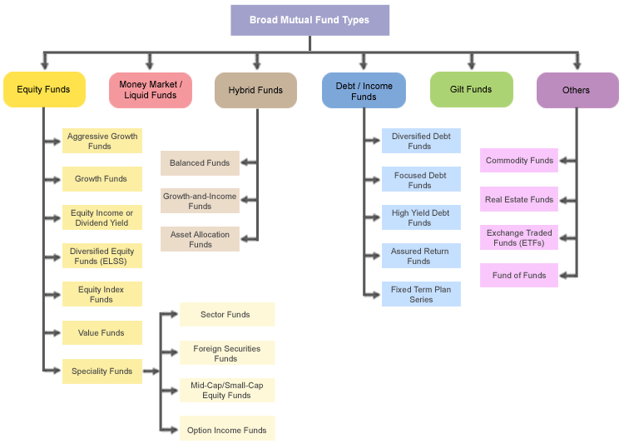
Classification of Mutual Fund
Notes:
A type of mutual fund with the goal to generate current income for its investors from the premium it earns by selling option contracts. The profits investors earn on the options are taxed as ordinary income, not as dividends, so option income funds are best held in tax-advantaged accounts. This income generating strategy is much riskier than investing in dividend paying stocks, although the returns can be much higher.

Slide 32
Example of China Mutual Type
CSRC基金分类：
  股票型（股票资产占比>80%）
  债券型（债券资产占比>80%）
  货币型（仅投资于货币）
  混合型（股票、债券、货币，且不符合前两项比例）
  短期理财债券型
  QDII

Slide 33
China Fund Distribution Channel
 | Banks | Securities companies | FMCs | Third-party sales
Subscription fees | around 20% discount (online banking) | 10%-40% discount | usually 40%-60% discount | 0.8-1.2%, fixed income funds 1.5-1.8%, stock funds up to 60% discount (online)
Availability of purchase | Banking hours 24-hour, online banking | business hours | business hours of counter 24-hour, direct sales branches | 24-hour, online
Fund types | Fund in custodianship Proxy funds | diverse types, including closed-end funds, ETF, LOF | FMCs’ own fund products | fund supermarket, a wide range of funds
Branch network | Broadest branches networks | fewer than banks but more than FMCs | fewer than banks or securities companies; but some large FMCs have many sales branches | a few, but quite convenient due to the internet
Target investors | all kinds of investors, especially those with relevant bank accounts | ordinary investors, mostly clients of the securities company | institutional investors HNWIs | specialized investors investors who prefer online purchase
Commercial banks
Securities companies
Direct sales by FMCs
____________________
Source: State Street Hangzhou Financial Research.

Slide 34
Session 3 Mutual Fund Market

Slide 35
全球的投资基金
In North American: Mutual fund
In Euro: UCITS (Undertakings for Collective Investment in Transferable Securities)
UK/HK: Unit Investment Trust (UIT)
In Japan: ITM Fund (Investment Trust Management Fund)
Others…
Notes:
日本台湾的叫证券投资信托基金（Security Investment Trust Fund）
香港 Mainland-Hong Kong Mutually Recognized Publicly Offered Funds
欧盟可转让证券集合投资计划Undertakings for Collective Investment in Transferable Securities

Slide 36
投资基金的发展历史
Origination: In the Europe
  First in Holland
  1868, first public fund in UK
Continuation: In the USA
  Mutual fund emerge and prosper
Development Stage
  Private fund→ Closed-end fund→ Open-end fund

Slide 37
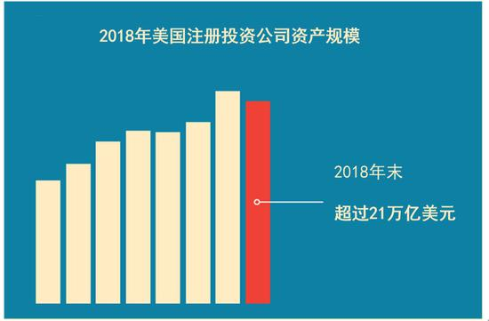
开放式基金的发展：2018年的美国基金行业
21万亿美元（>50%）
总规模的89%为散户持有
44%家庭（5490万户）投资基金
近1万只共同基金（9599）
846家大大小小的基金公司
Notes:
21万亿为基金总规模包括：共同基金，封闭式基金，ETF，单位投资信托
2018年末美国ETF规模3.4万亿美元 占全球ETF的71%

Slide 38
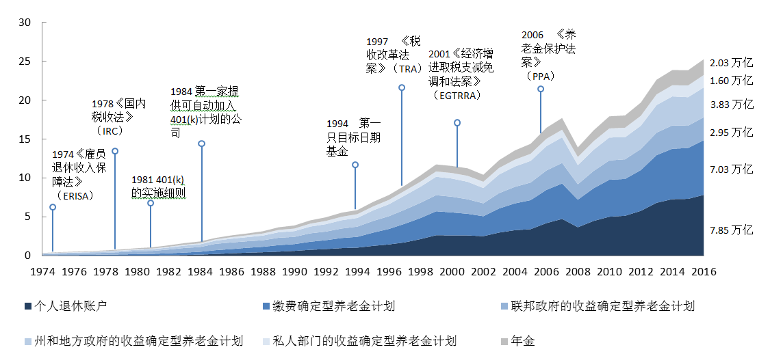
开放式基金的发展：2018年的美国基金行业

Slide 39
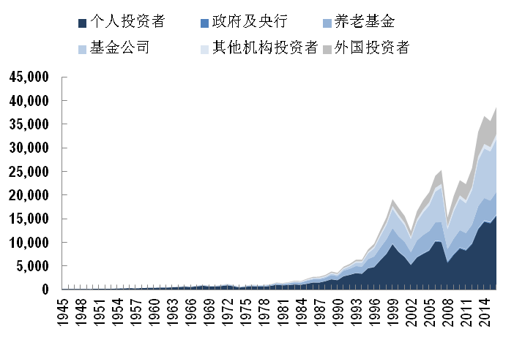
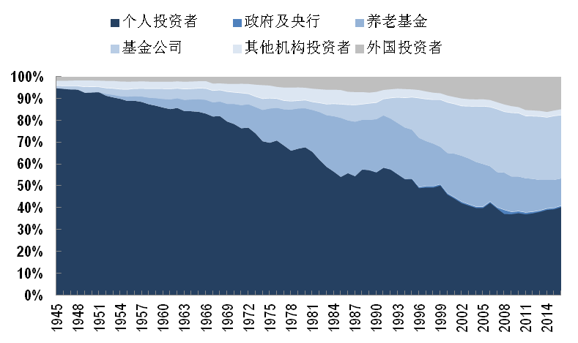
开放式基金的发展：2018年的美国基金行业
资料来源：美联储 z1 Financial Accounts of the United States

Slide 40
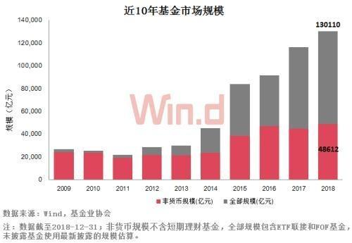
中国的基金市场：2018年的中国基金业
131家基金公司
5000+基金
13.01万亿（CNY）
趋势：指数化，私转公

Slide 41
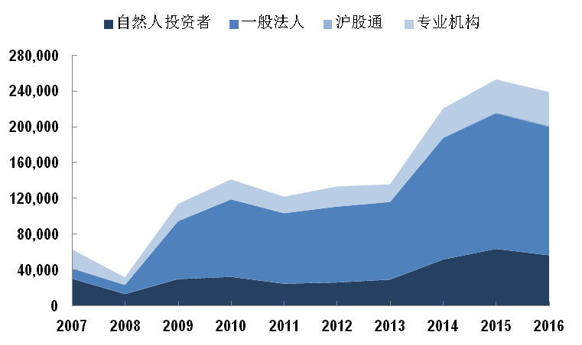
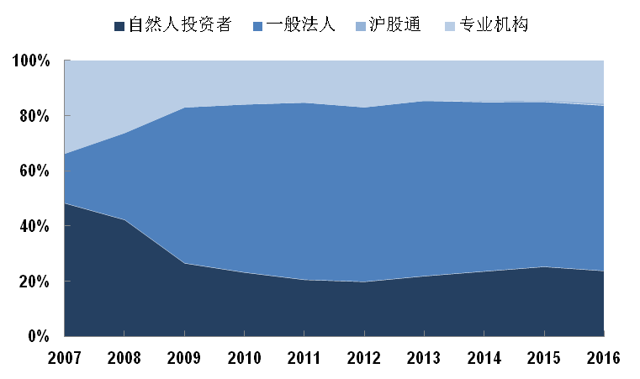
中国的基金市场： 2018年的中国基金业
资料来源：上交所统计年鉴

Slide 42
Who are the players?
Individual
Mutual Fund Company
Investment Manager 投资管理人
Broker
Custodian Bank 托管人
Shareholder Service

Slide 43
Who are the players? - 基金董事
若共同基金以公司的形式设立就有董事，若以信托的形式设立就有信托人。在实践中，它们是完全相同的组织，基金业内使用这两个词的意思也是相同的。
董事要确保基金的服务提供机构特别是管理公司为基金持有人的最大利益尽职尽责。
由于认识到董事隶属于管理公司，存在内在的利益冲突，1940年以及1970年的《投资公司法》及其修订案强化了董事的独立性，“独立”被定义为与管理公司、投资顾问、主销售商、法律咨询机构或任何交易成员没有隶属关系。

Slide 44
Who are the players? - 基金管理公司
大多数基金不是孤立地存在，而是由专业运营共同基金的机构——管理公司组织起来的一个基金家族类的一部分，并从中得到共同的服务。
管理公司一般都要提供或者监督全部核心的服务，包括基金行政管理、投资顾问、主销售和过户代理处理。通常情况为每个服务单位被设置成为管理公司的一个独立子公司。

Slide 45
Who are the players? - 第三方服务提供商
FM players
因法规（如托管、审计），或者规模经济的考虑，管理公司将一些服务转包给外部服务商。
  投资顾问
  过户代理人
  基金会计人
  托管人
  审计人
  咨询和法律事务公司
  分析师和评级代理人

Slide 46
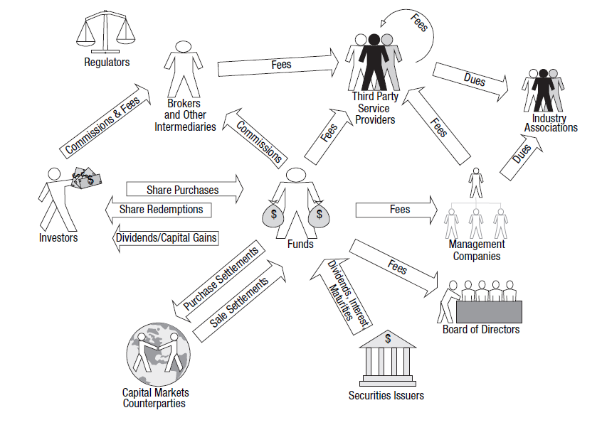
Workflow of FMCs

Slide 47
Front, middle and back office of FMCs
FMC business
1. The concept of middle and back office
2. Business lines of investment management companies
  Security trading
  Unit distribution processing
3. Investment middle and back office functions
  Information technology
  Risk Management/Compliance
  Clearing & Settlement
  Accounting & Valuation
  Transfer agency

Slide 48



The Concept of middle and back office
Concept Origination: Investment bank
Accepted and expended to other professionals
No authoritative definition
Front Office
Middle Office
Back Office
Sale/Client oriented
Revenue generation
Bridge between front and back office
Trade/Sales support
Do not generate revenue
Incur great losses if fails

Slide 49
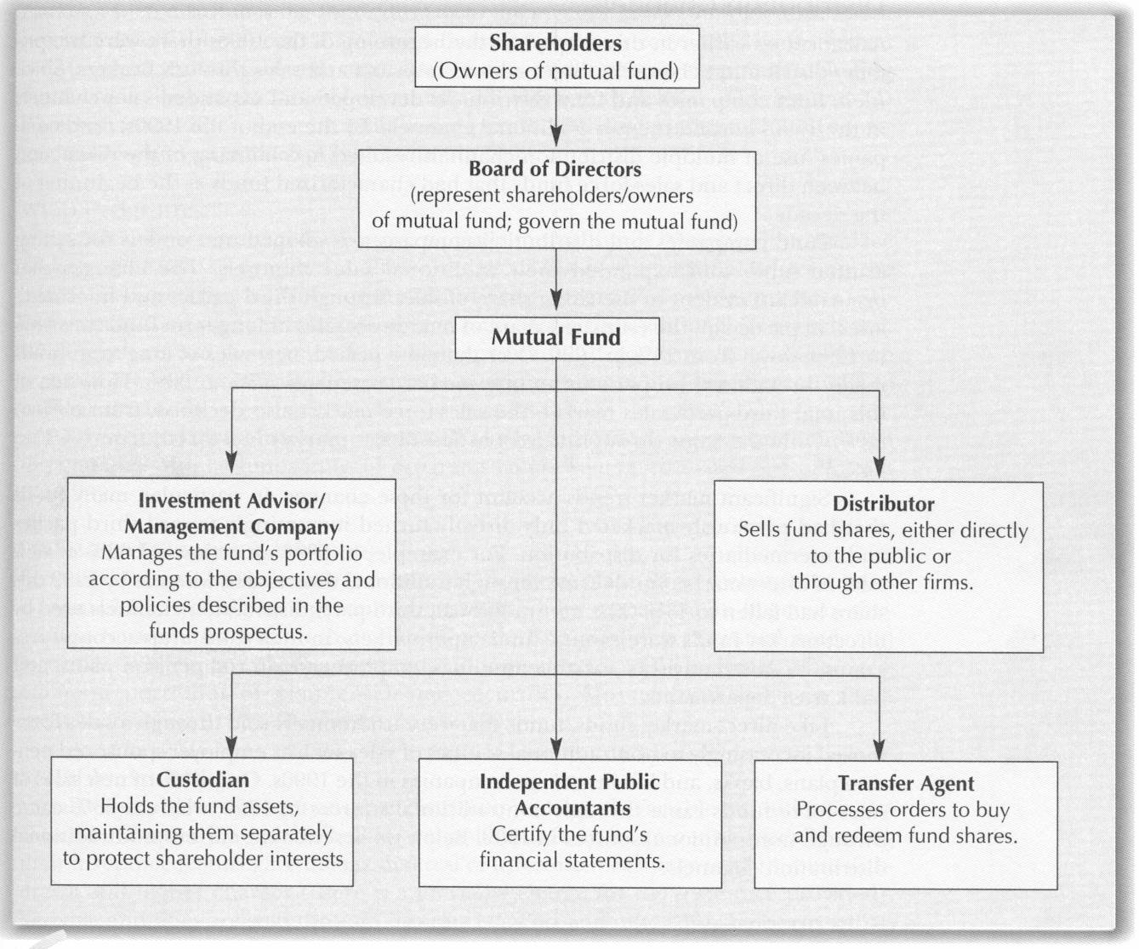
Structure of FMC

Slide 50
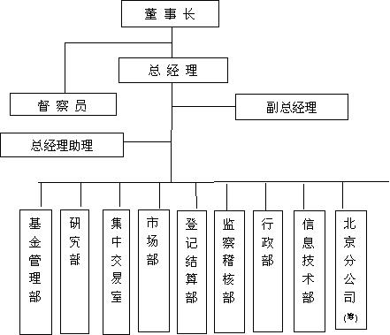
基金公司组织架构图

Slide 51
Business lines of IM Companies 1: Portfolio Management
Portfolio
Management
Broker &
Trading
Networking
Trade orders
Market & Analytical data
Research &
Analysis
Trading
Clearing & Settlement
Agents
Portfolio Data
External information Provider
Trades
Custodians
Price
Monitoring &
Reporting
Trade
Settlement
Investment
Operations

Slide 52

Business lines of IM Companies 2: Unit distribution
FMC business
Plan participants
Retail Investors
Indirect distribution
Direct distribution
Financial
advisor
Broker
Bank
MF Super Market
NSCC
Mutual Fund
Transfer Agent
Order
Aggregation

Slide 53
IM Middle and Back office functions landscape
IM companies
Asset
Gathering
Investment
Decision
Trade
Execution
Risk/
Compliance
Operations
Custody
Transfer
Agency
Third
Party
Independent
Distributer
Sell Side
Research
Broker
Dealer
Info.
Vender
Broker/Dealer
Investor/
Custody
Custodian/
Trustee
Investor
Retail Units
Fund inflows
Register/ TA
Inv. Decision
Making
Trade allocation
Order Management
Order routine
Risk man.
Market risk
Credit risk
Operational risk
Post-trade compliance
IT support
Settlement monitoring
Accounting/valuation/reporting
Custodianship
Clearing and Settlement
Asset servicing
Accounting/valuation/reporting
Dividend/CA processing/Tax reclaim
Liquidity Management (Security lending/
Collateral management)
Subscription and Redemption
Register
Call center (Client service)
Tax processing
Commission calculation/reporting
Asset Allocation
Liability assessment
Asset class
Strategic allocation
Institutional
Plan sponsor coverage
Investor marketing
Direct client
Fund inflows
Register/TA
Pre-trade compliance
Risk attribution
Core competence:
Marketing
Research/Asset allocation
Risk Management
Front office
Middle office
Back office

Slide 54
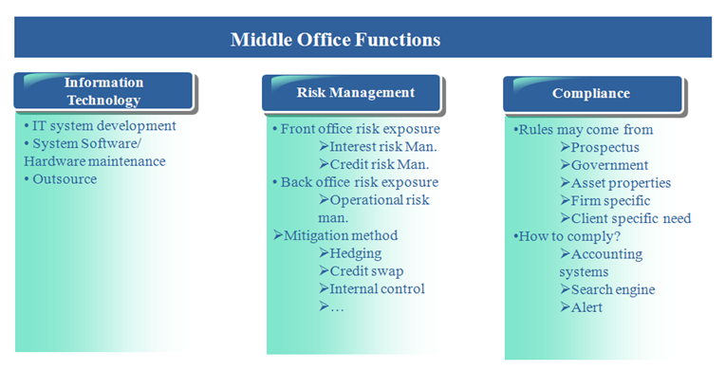
Middle Office Function

Slide 55
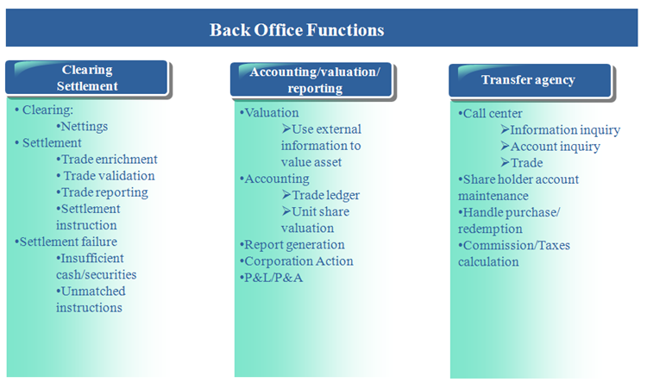
Back Office Function

Slide 56
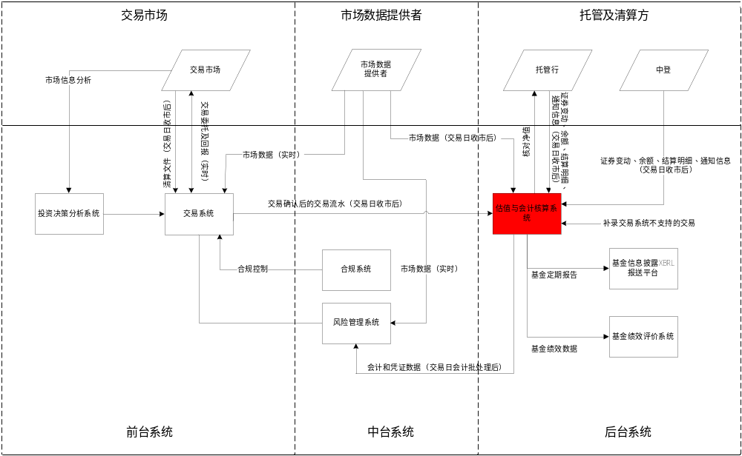
中国目前的传统托管流程

Slide 57











中国目前的传统托管流程
China Current Custodian Model - Generic exchange securities trading workflow
4. Brokers reconsile order details
券商协调交易细节
2. Order delivery
交易委托
2. Order delivery
交易委托
Broker
经纪人(券商)
Exchange
交易所
Counterparty
Broker
对手方券商
3. Matched, return confirmations
成交确认
3. Matched, return confirmations
成交确认
1. Buy orders
买的指令
1. Sell orders
卖的指令
5. Notify custody bank
通知托管行
4.Notify registration & repository
发送成交数据
5. Notify custody bank
通知托管行
FMC
基金公司
Trade
Counterparty
交易对手方
NAV Recon
净值确认
6. Settlement confirmation
结算确认
6. Settlement confirmation
结算确认
NAV Recon
净值确认
7. Notify R&R to complete settlement
成交数据结算完成
7. Notify R&R to complete settlement
成交数据结算完成
Custody
托管银行
CSDs
中央结算
中证登，中债登，上清所
Counterparty Custody
对手方托管银行
Recon
份额/头寸/资金确认
Recon
份额/头寸/资金确认
8. Fund transfer
资金交收
Payment System
结算银行
8. Fund transfer
资金交收
Block Chain

Slide 58
Session 4 Mutual Fund Analysis

Slide 59
Let’s Start to pick up funds
1. American Funds
US has around 10000 mutual funds. How to choose those funds suites you most?
https://www.americanfunds.com/default-home.htm
2. Chinese funds
http://fund.csrc.gov.cn/web/fund_type_affiche.fund_affiche
http://finance.sina.com.cn/fund/

Slide 60
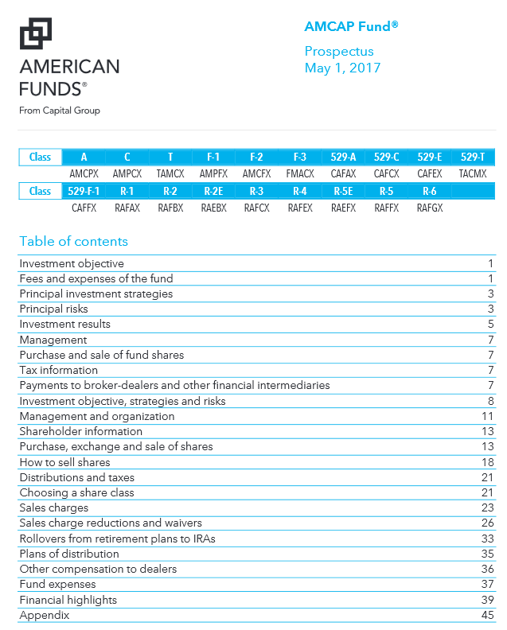
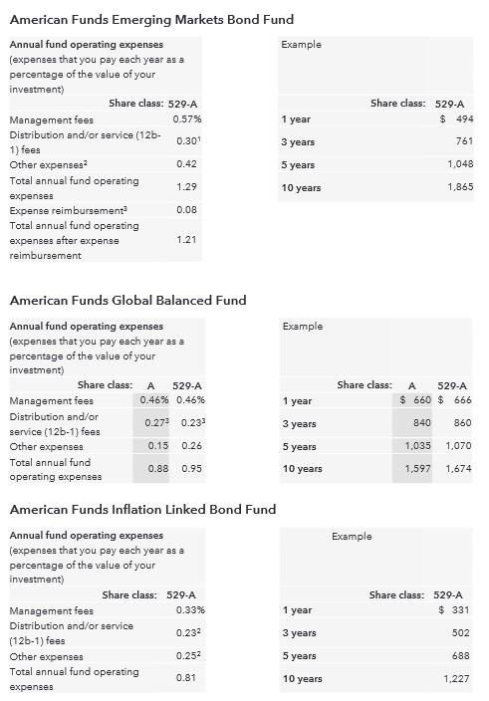

Slide 61
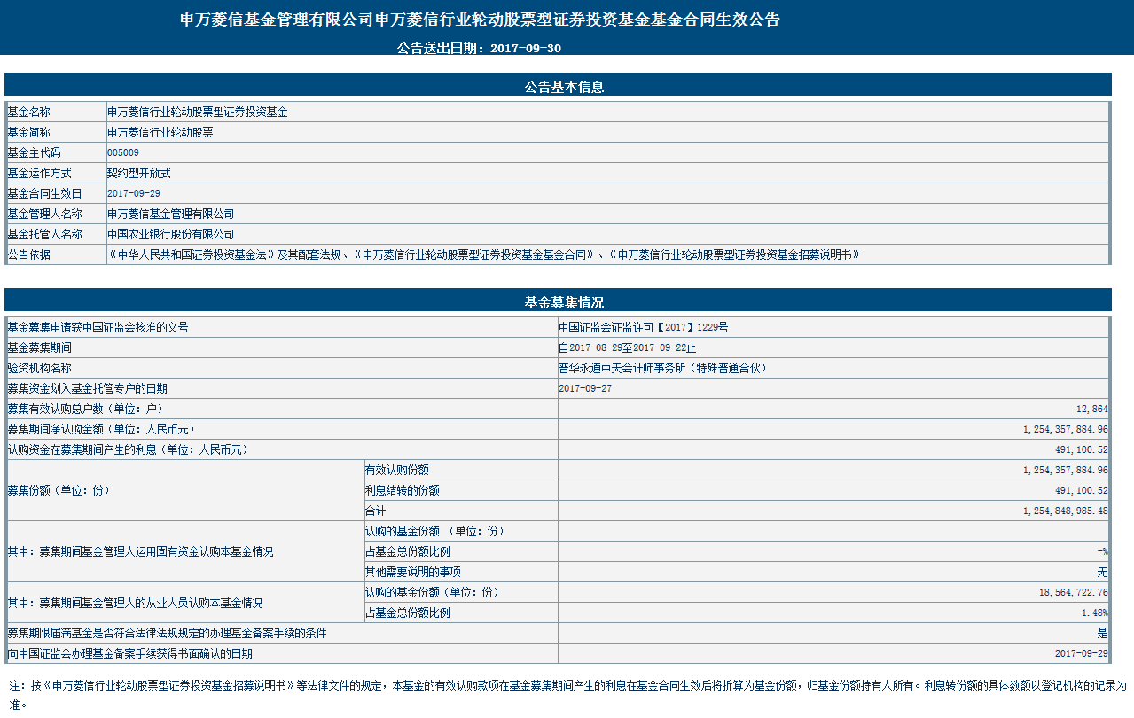

Slide 62
How to Choose Your Own Mutual funds
Different Types of funds has different return & risk characteristics
Even funds within the same typology, they may have different investment strategy, expected return and risk features
Before making investment decision, investor should know
  investment objective
  risk tolerance
  investment time horizon
  Fund characteristics

Slide 63
Step 1: Know yourself
Understand your investment objective & risk tolerance
  What do you expect from the investment
    Eg: breakfast from YUEBAO?
    Generate cash flow
    Buy a house in 5 years?
  Your risk tolerance
    The Younger the investor, the better of risk tolerance; aggressive
    People in their Middle age, average risk tolerance
    Old aged, conservative
  Risk tolerance also related to your wealth
  Personal Risk Appetite

Slide 64
Step 2: Understand investment Horizon
Long Term: Equity & Bond; Short term: Money market
5 years 7 above: Stock Funds: High volatility, high expected return
3~5 years: Distribution among Equity & Fixed income funds; Balanced funds
3~5 years (conservative): Principle protected funds
Less than 2 years: Fixed income funds
Cash equivalent: Money market funds
Notes:
理清资金的性质很重要，可以长期使用的资金可以投资于股票型基金和混合基金，而短期资金需要流动性，则适合投资债券型和货币型的基金
股票型基金预期收益率较高，但不适合短期投资，其投资期一般应该5年以上。这样既可以抵御一些投资价值短期波动的风险，又可获得长期增值的机会，预期收益率会比较高。这里需要强调的是，我们一定要捺得住长期投资的寂寞，在2006年的牛市行情中，如果自己手中的股票型基金一直持有，那么收益翻番便轻而易举，但很多人选择了提前赎回。因此建议投资者在股票市场上涨趋势明显的情况下，一定要耐心持有手中的优质基金。
保本基金是在一定的投资期内（比如3年或5年），为投资者提供一定本金保障的理财品种，因此也适合长期投资。如果中间赎回的话，不但手续费高，本金也无法得到保障。
投资期限2－5年的中期投资，除了股票类基金这类风险高的基金产品，还要加入一些收益比较稳定的债券型或平衡型基金，以获得比较稳定的现金流。
投资期限在2年以下的短期投资，投资的重点就应该放在债券型基金、货币市场基金这类低风险、收益稳定的基金产品上。货币基金，流动性几乎等同于活期存款，又因其不收取申购、赎回费用，投资者在用款的时候可以随时赎回变现，是短期投资者现金管理的工具。

Slide 65
Step 3: Know Your Investment
What do they do with your money?
What are the investment returns?
What are the risks are you facing?
How do they charge you?
Etc.

